Slide 1
Russian Language in the United States
By Rachel swyhart

Slide 2
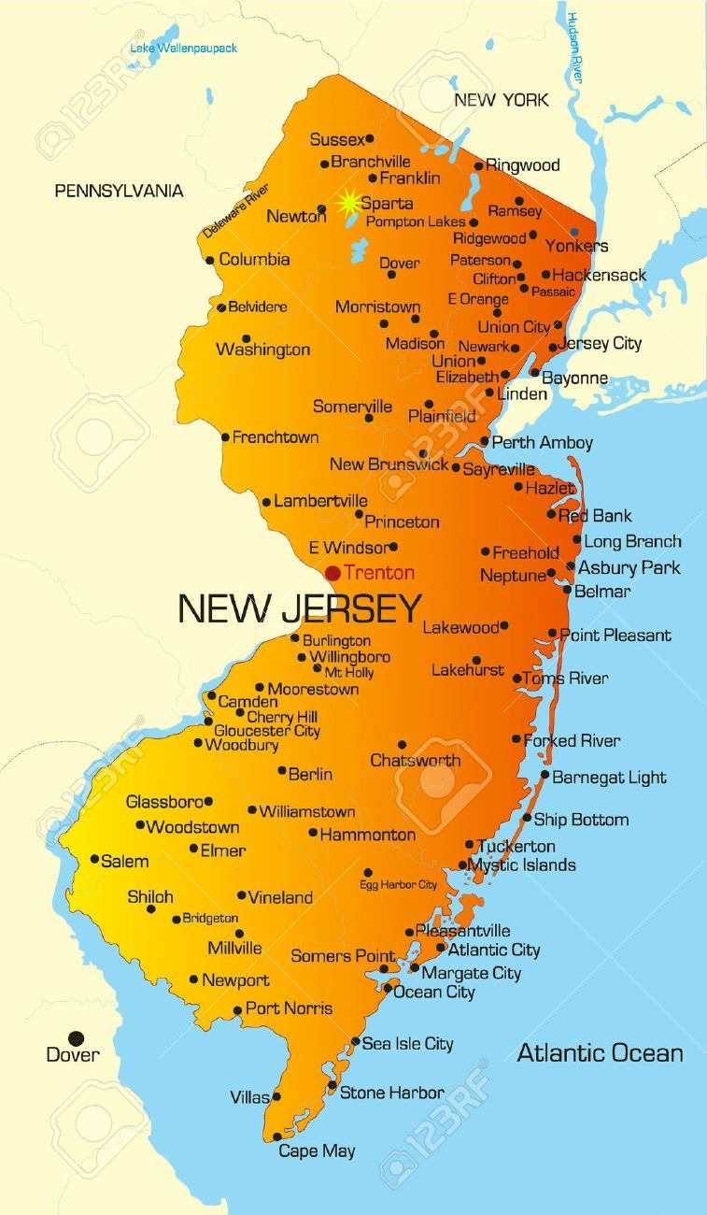
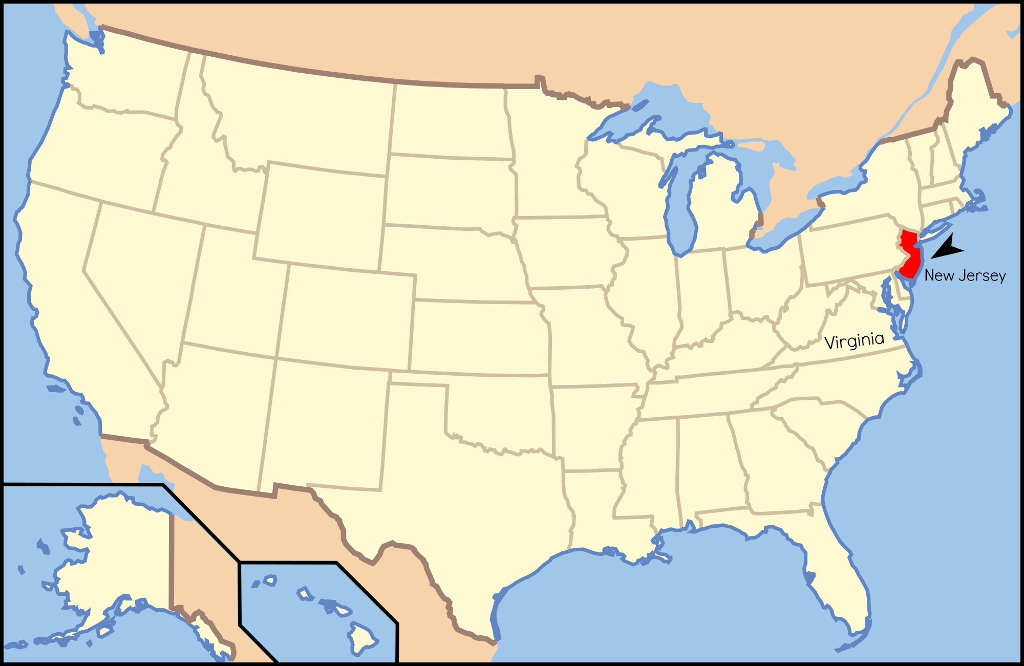
очень приятно!
My name is Rachel Swyhart, and I’m from the United States of America.
I’ve studied British Literature, Art, and Russian as a Foreign Language for 3 years.
I will graduate from Ferrum College, Virginia, in May 2017.
I’m 21 years old.
I was born in Sparta, New Jersey and I have lived in Virginia for 16 years.

Slide 3
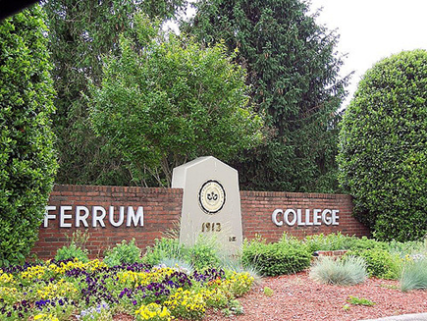
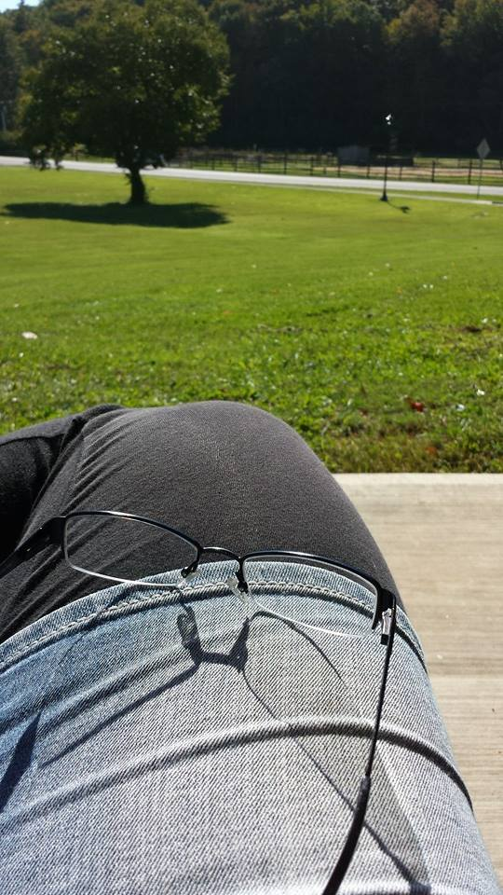
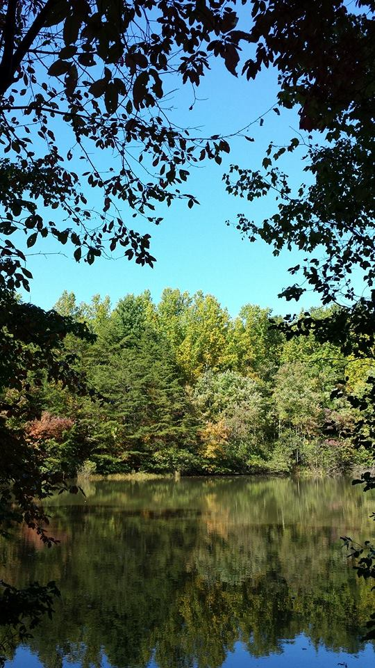
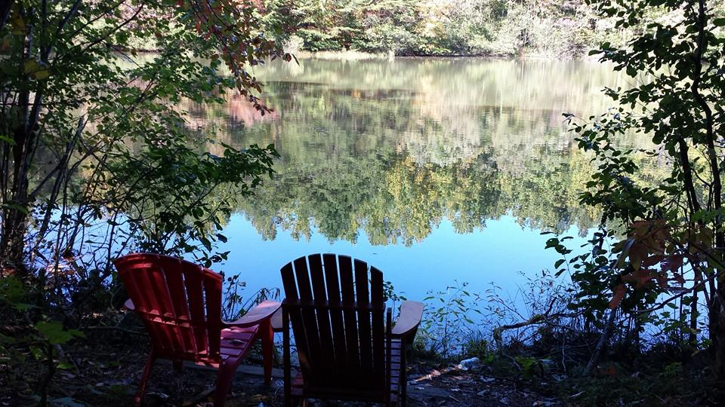

Slide 4
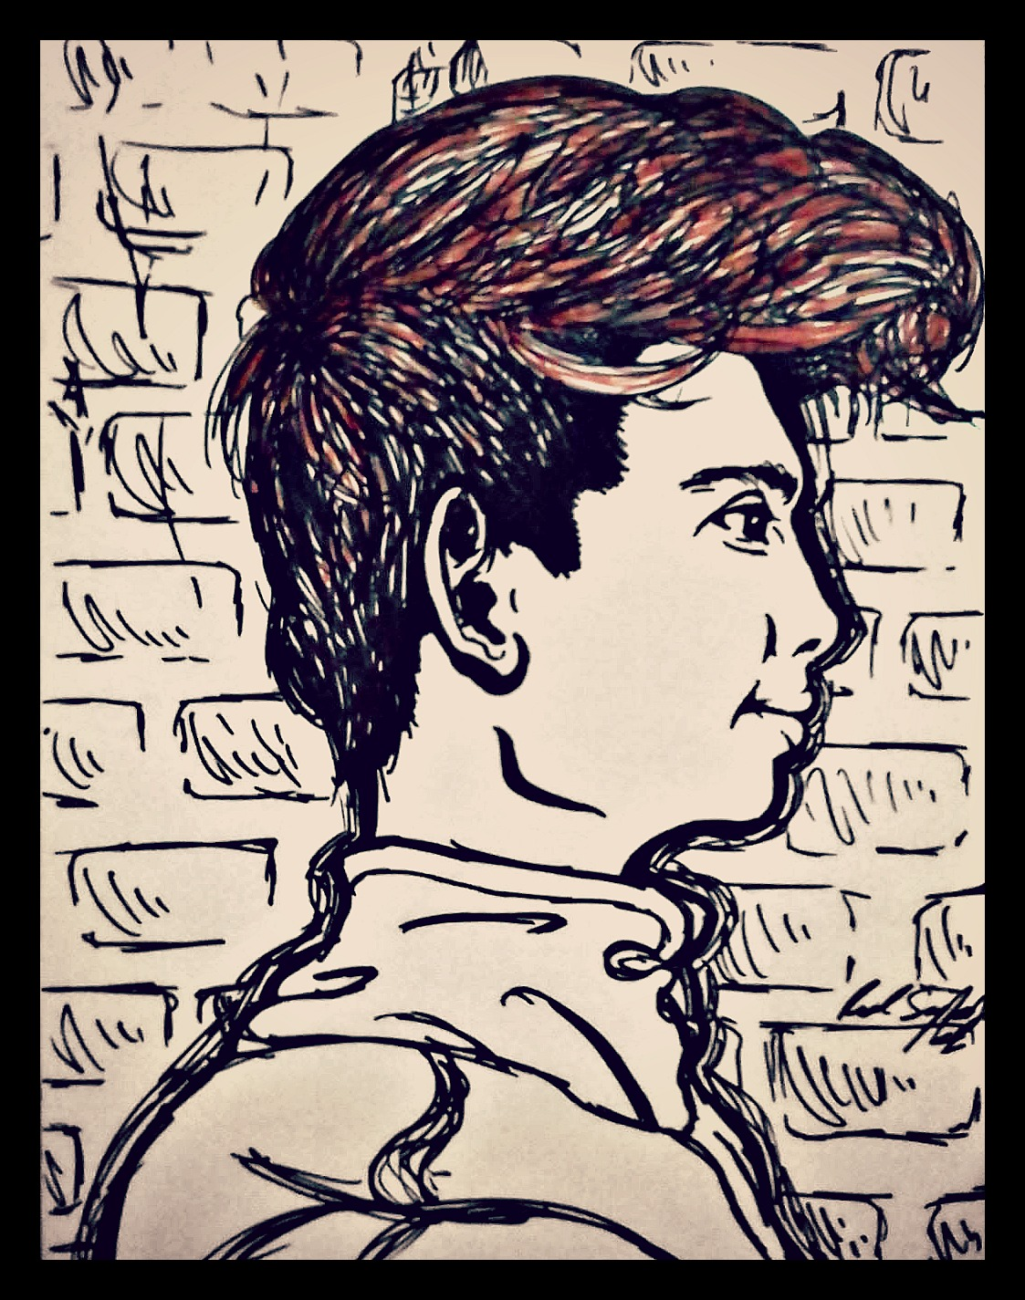
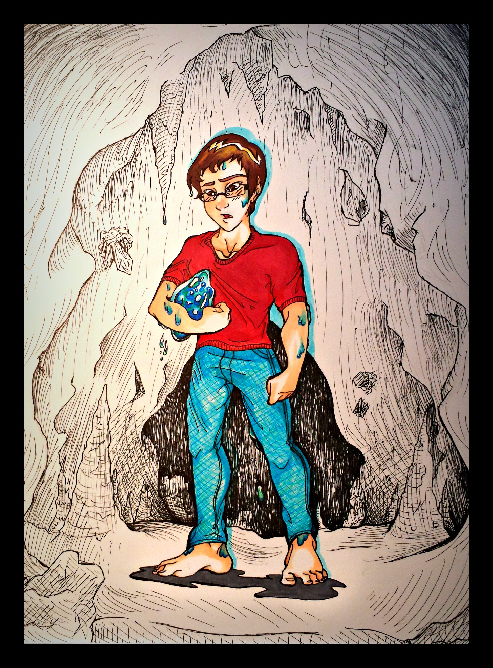
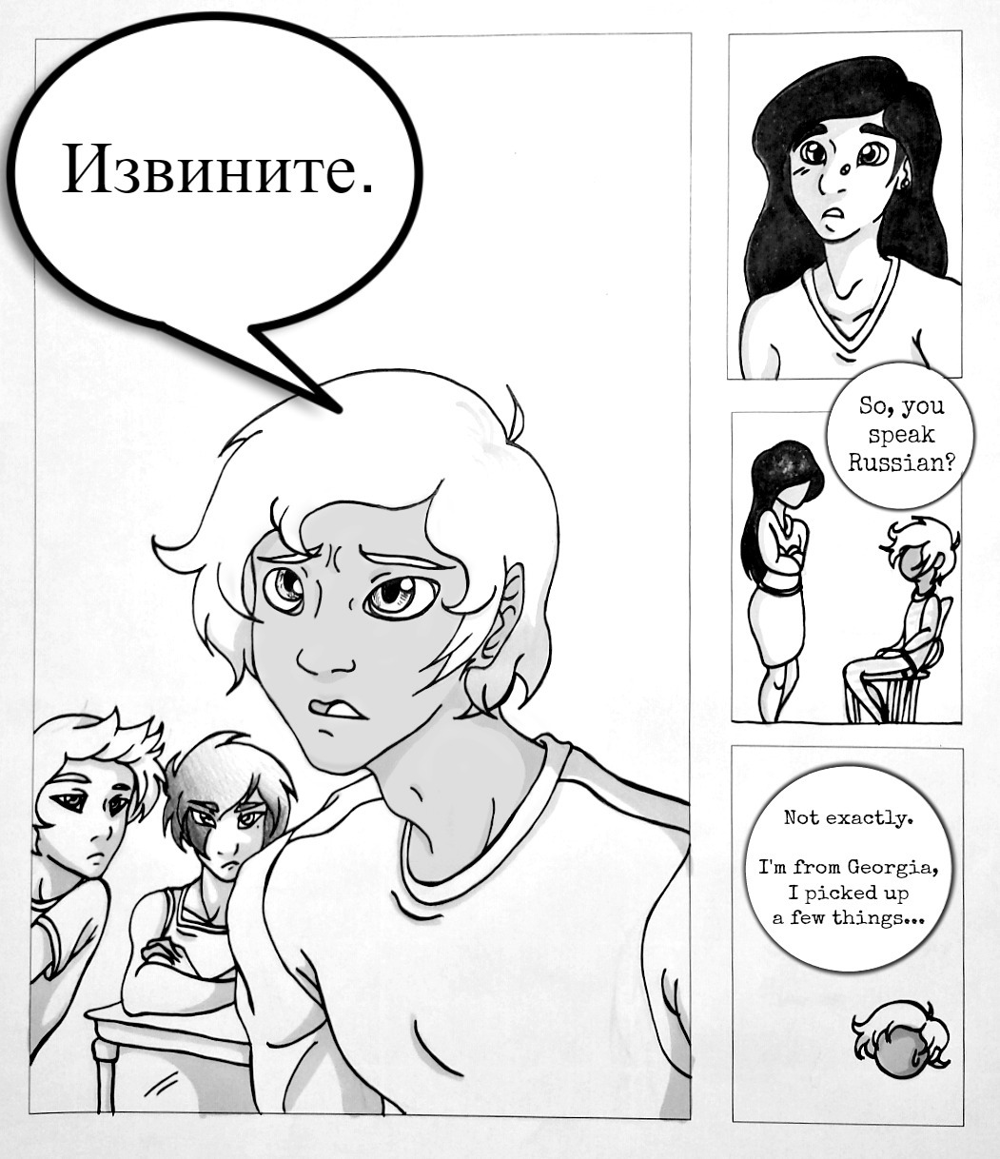
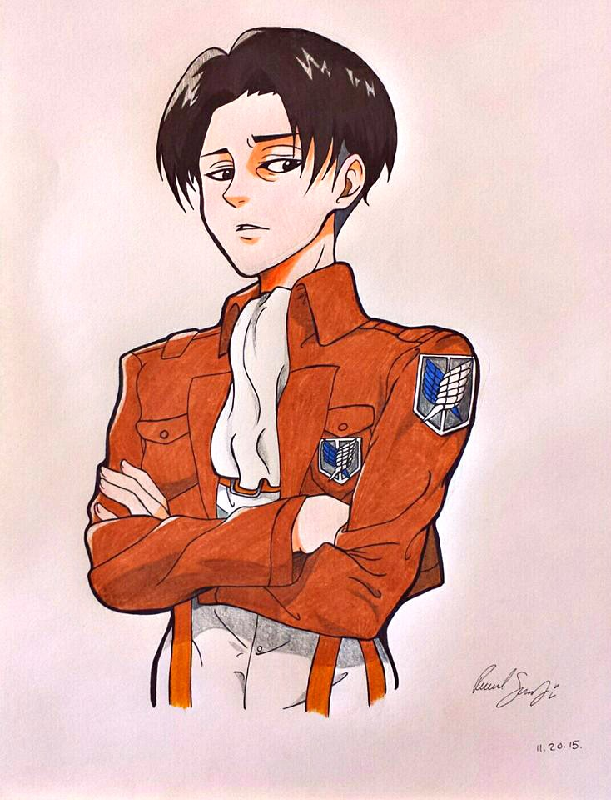
Artist, Author, Linguist?

Slide 5
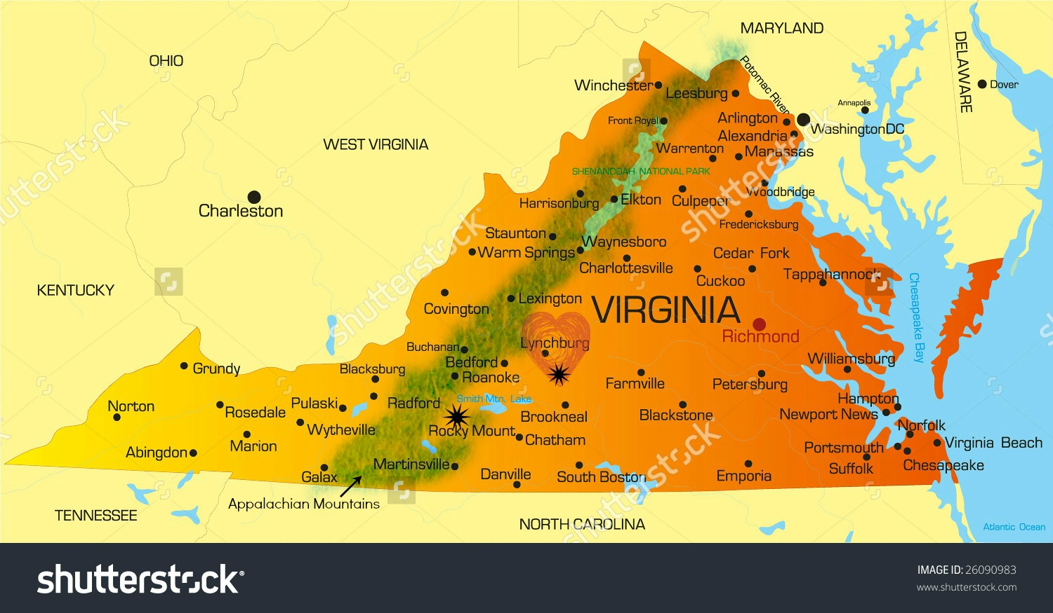
Virginia, USA
I grew up in Lynchburg, or
The Heart of Virginia.
The star close to Lynchburg is Rustburg, where I live now.
The second star is where my college is – Ferrum College.
Virginia is a state where the American Civil War was fought from April 12, 1861 – May 9, 1865.

Slide 6
Russian Language in The USA?
?

Slide 7
THERE IS ALMOST NONE!
In America, we hear nothing about the Russian language or Russia itself except President Putin. And all we know about Putin is that apparently he is amazing.
The people, landscape, culture, and especially the language are totally foreign to us!
We have lots of TV shows and movies with Russian characters that are always characterized the same way, but they only ever use Russian words like ‘до свиданья,’ or short phrases of the language to intimidate the audience. Often thugs, gangs, or hit men are portrayed as strong Russian men (and the women, of course, are always devastatingly beautiful).
Yes, things are really that bad.

Slide 8
Schools Currently Teaching Russian in the USA
“We have information on (only) 288 schools that teach Russian in the US. In the past, grant funding has allowed for free, bulk distribution of Russian Life to many of these schools, through our Language Through Culture Program.”
An estimated 80 of these schools are not colleges or universities.
So, Russian is mostly taught at the college level, where Russian programs are quite small or passed over for funding in place of languages like Latin, French, German, and Chinese.
The top universities teaching Russian are Stanford and Yale, two of the biggest and most affluent schools in America.
Most colleges teaching Russian are in New York, California, Massachusetts, or out in the Mid-West.

Slide 9
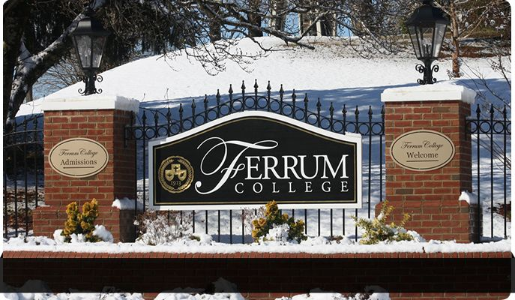
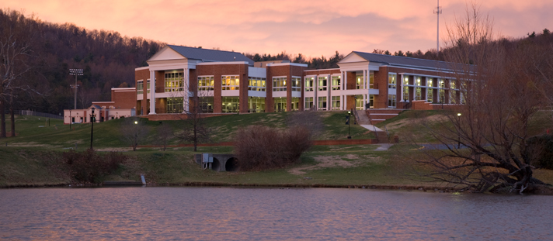
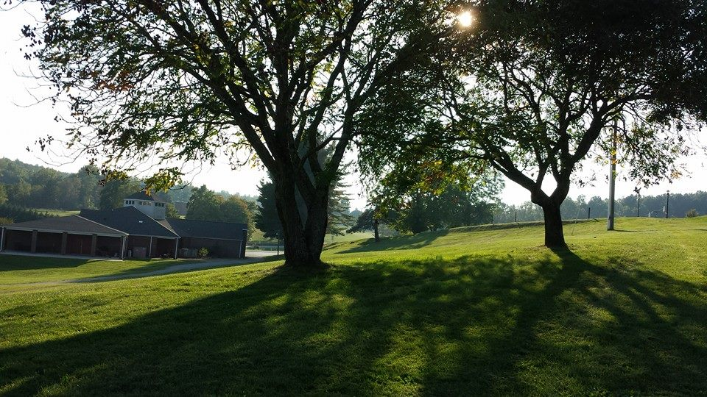
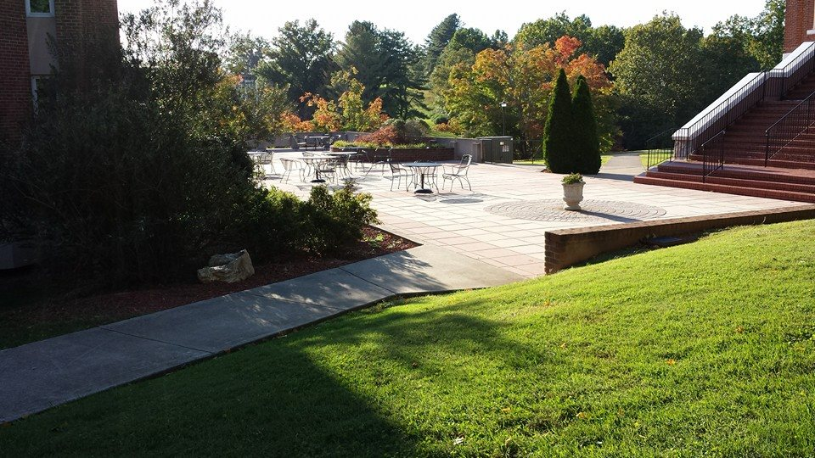
Ferrum College

Slide 10

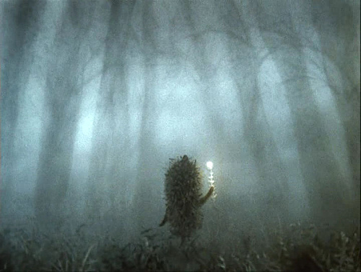

4 Years of Study Begin
Маша и Медведь
Ёжик в тумане
Чебурашка

Slide 11
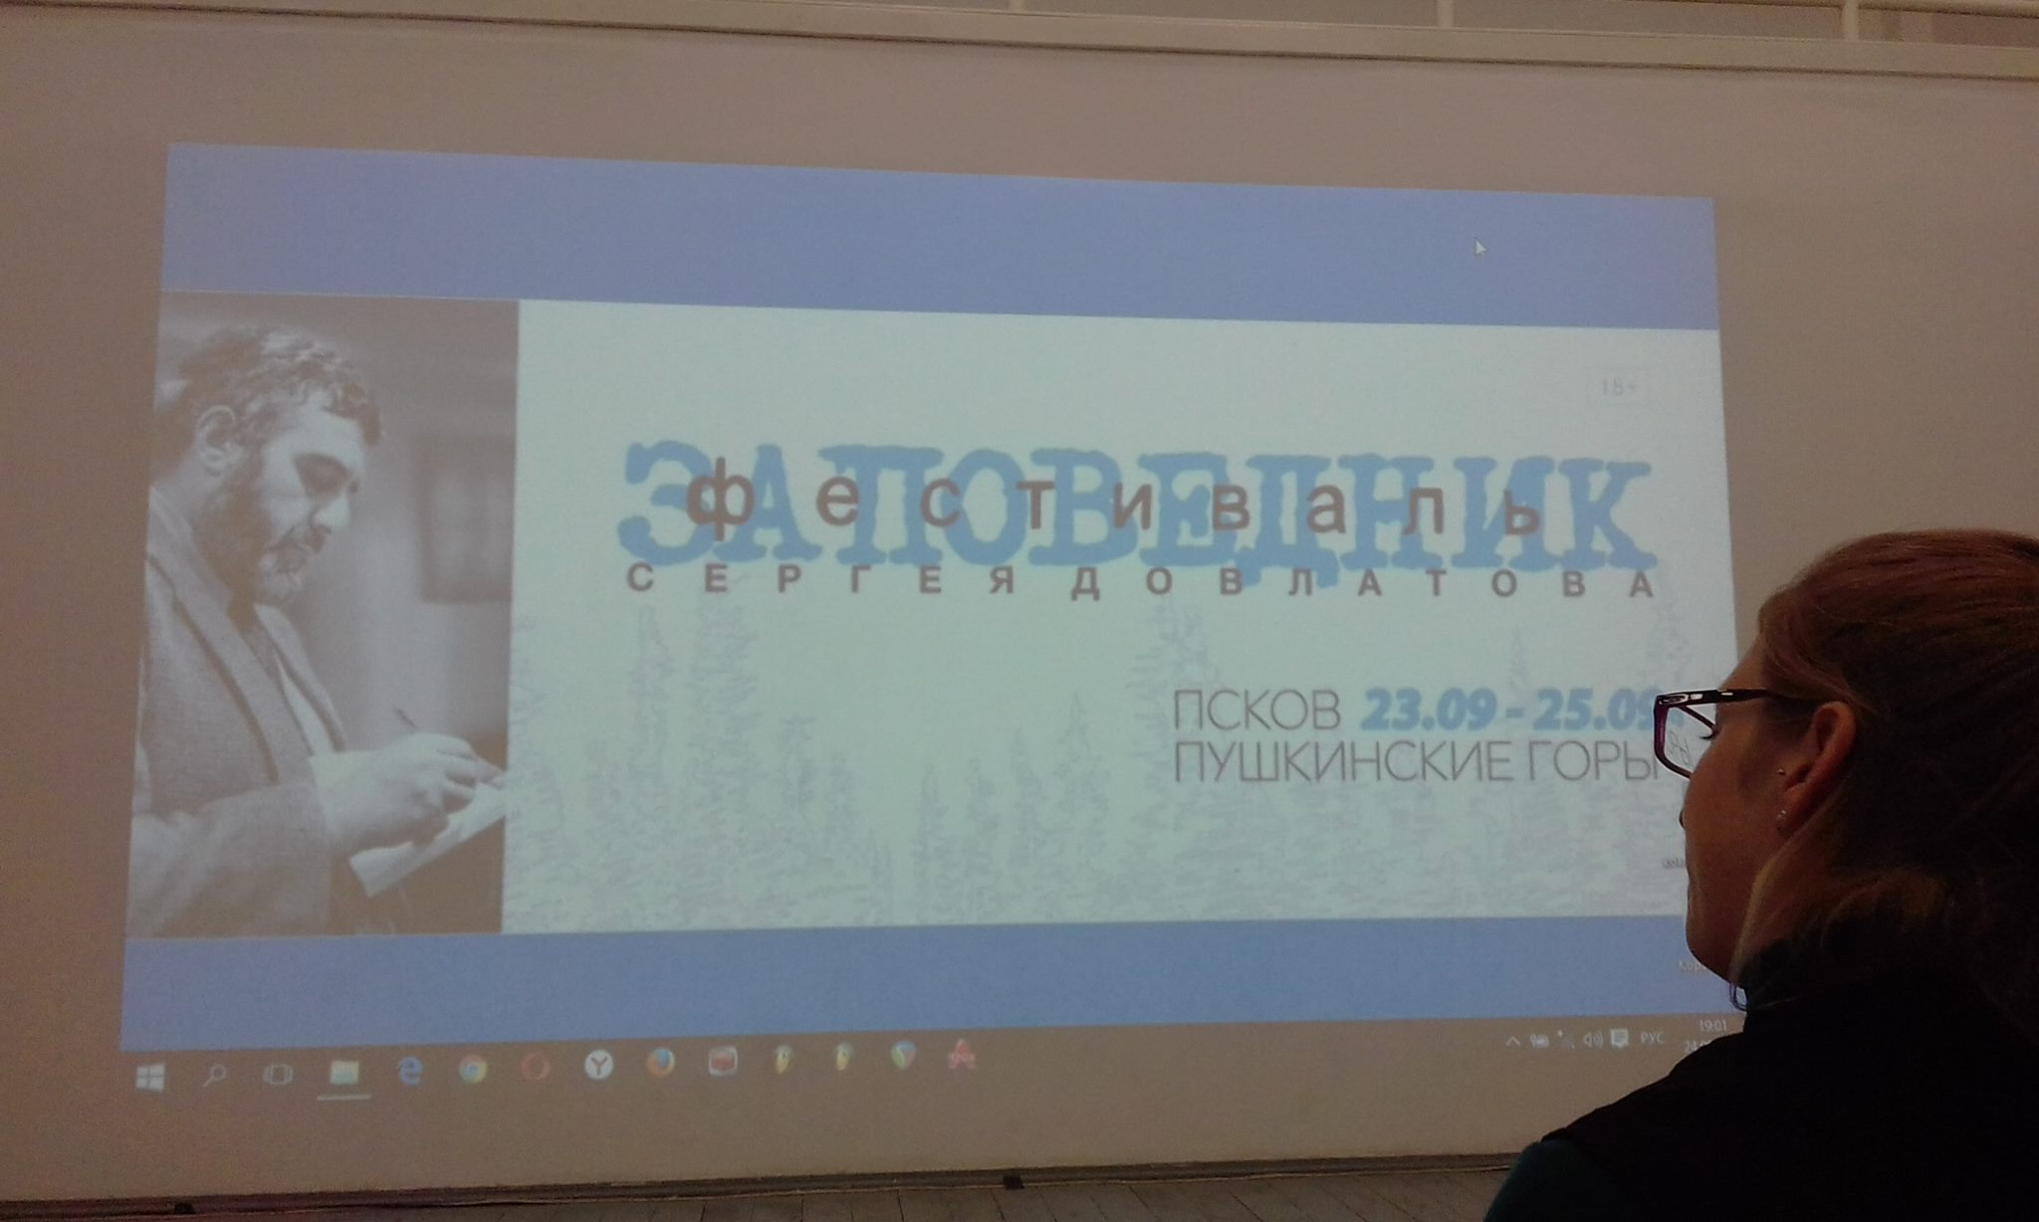
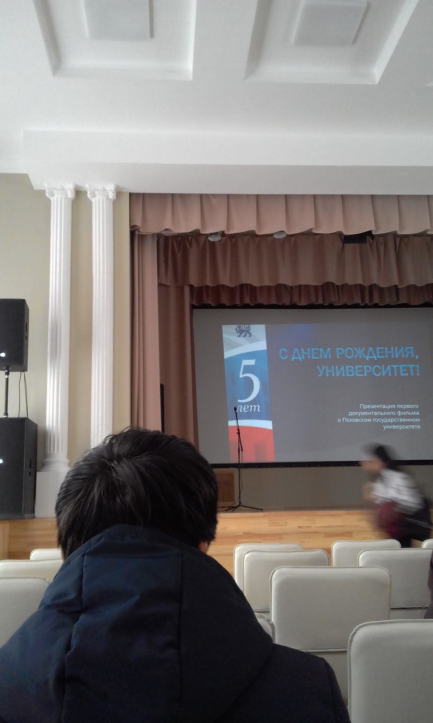
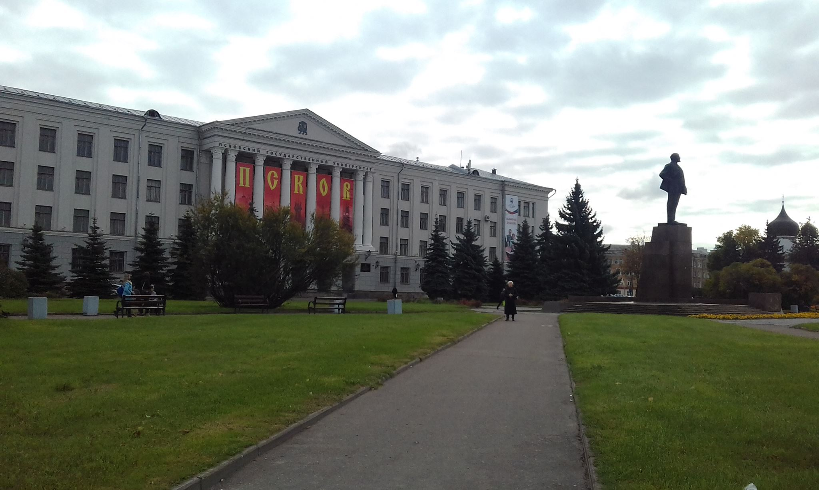
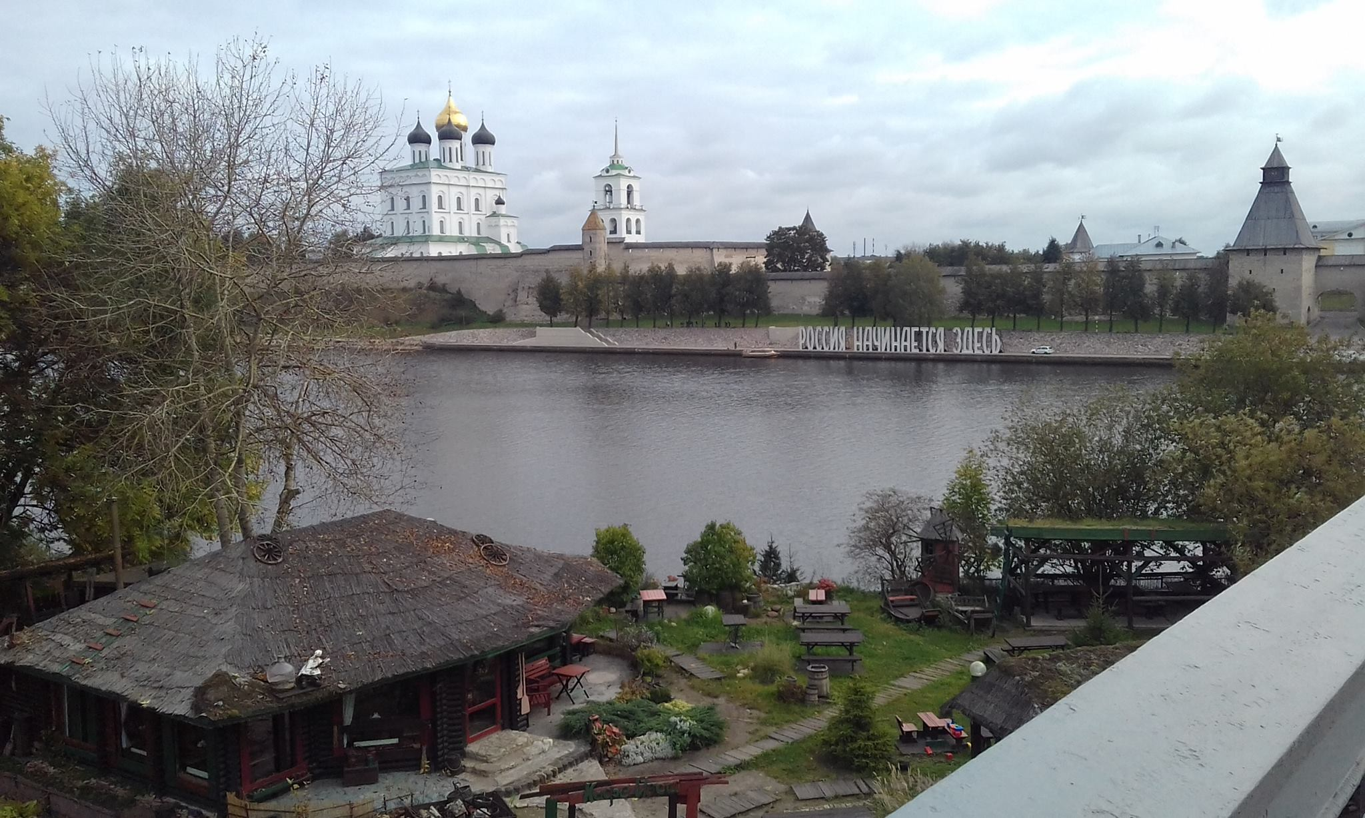
Pskov

Slide 12
Current Classes
Russian Language (1)
Russian Language (2)
Russia’s Modern History
Cultural Studies
Economics
Local Linguistics
Contemporary Political Issues
Political Science

Slide 13
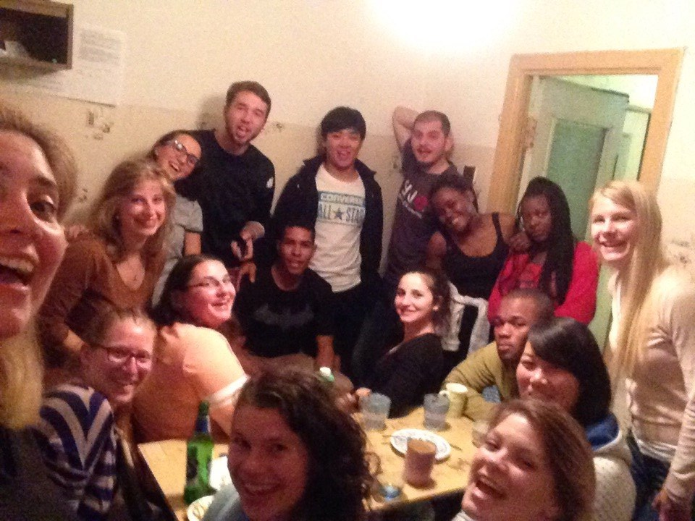
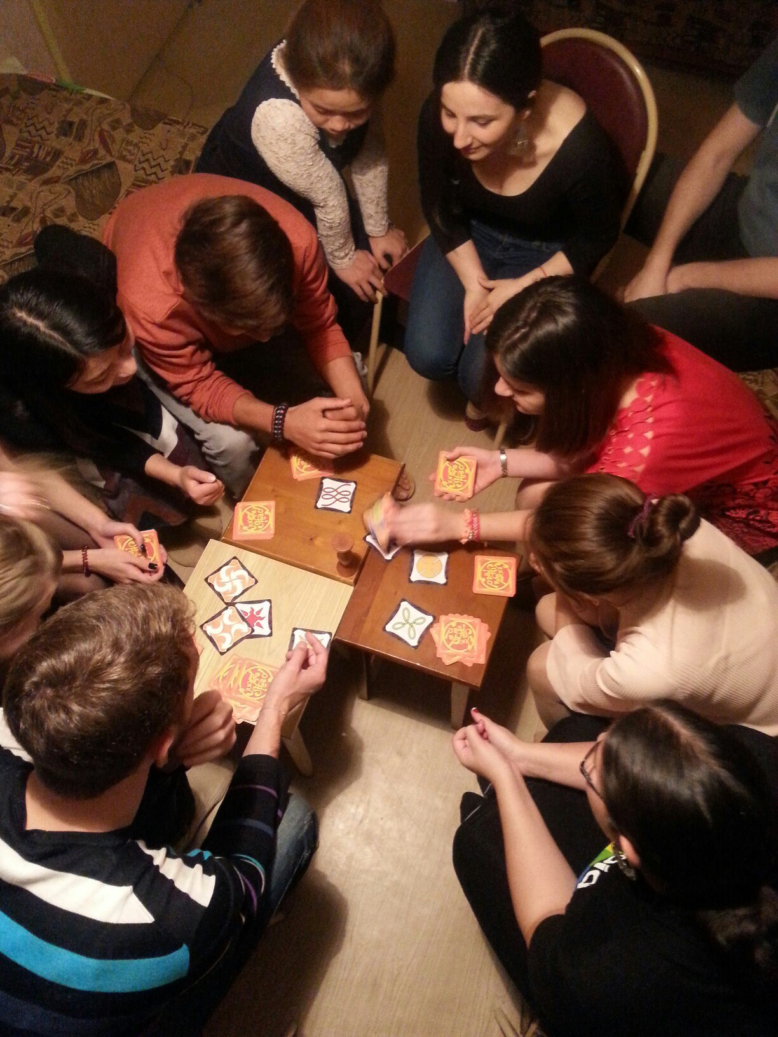
Language Barriers Being Broken
Argentina
Germany
Italy
Uzbekistan
Turkmenistan
Moldova
China
Costa Rica
The Netherlands
Finland
Turkey
Africa
Afghanistan
And, of course, Russia

Slide 14
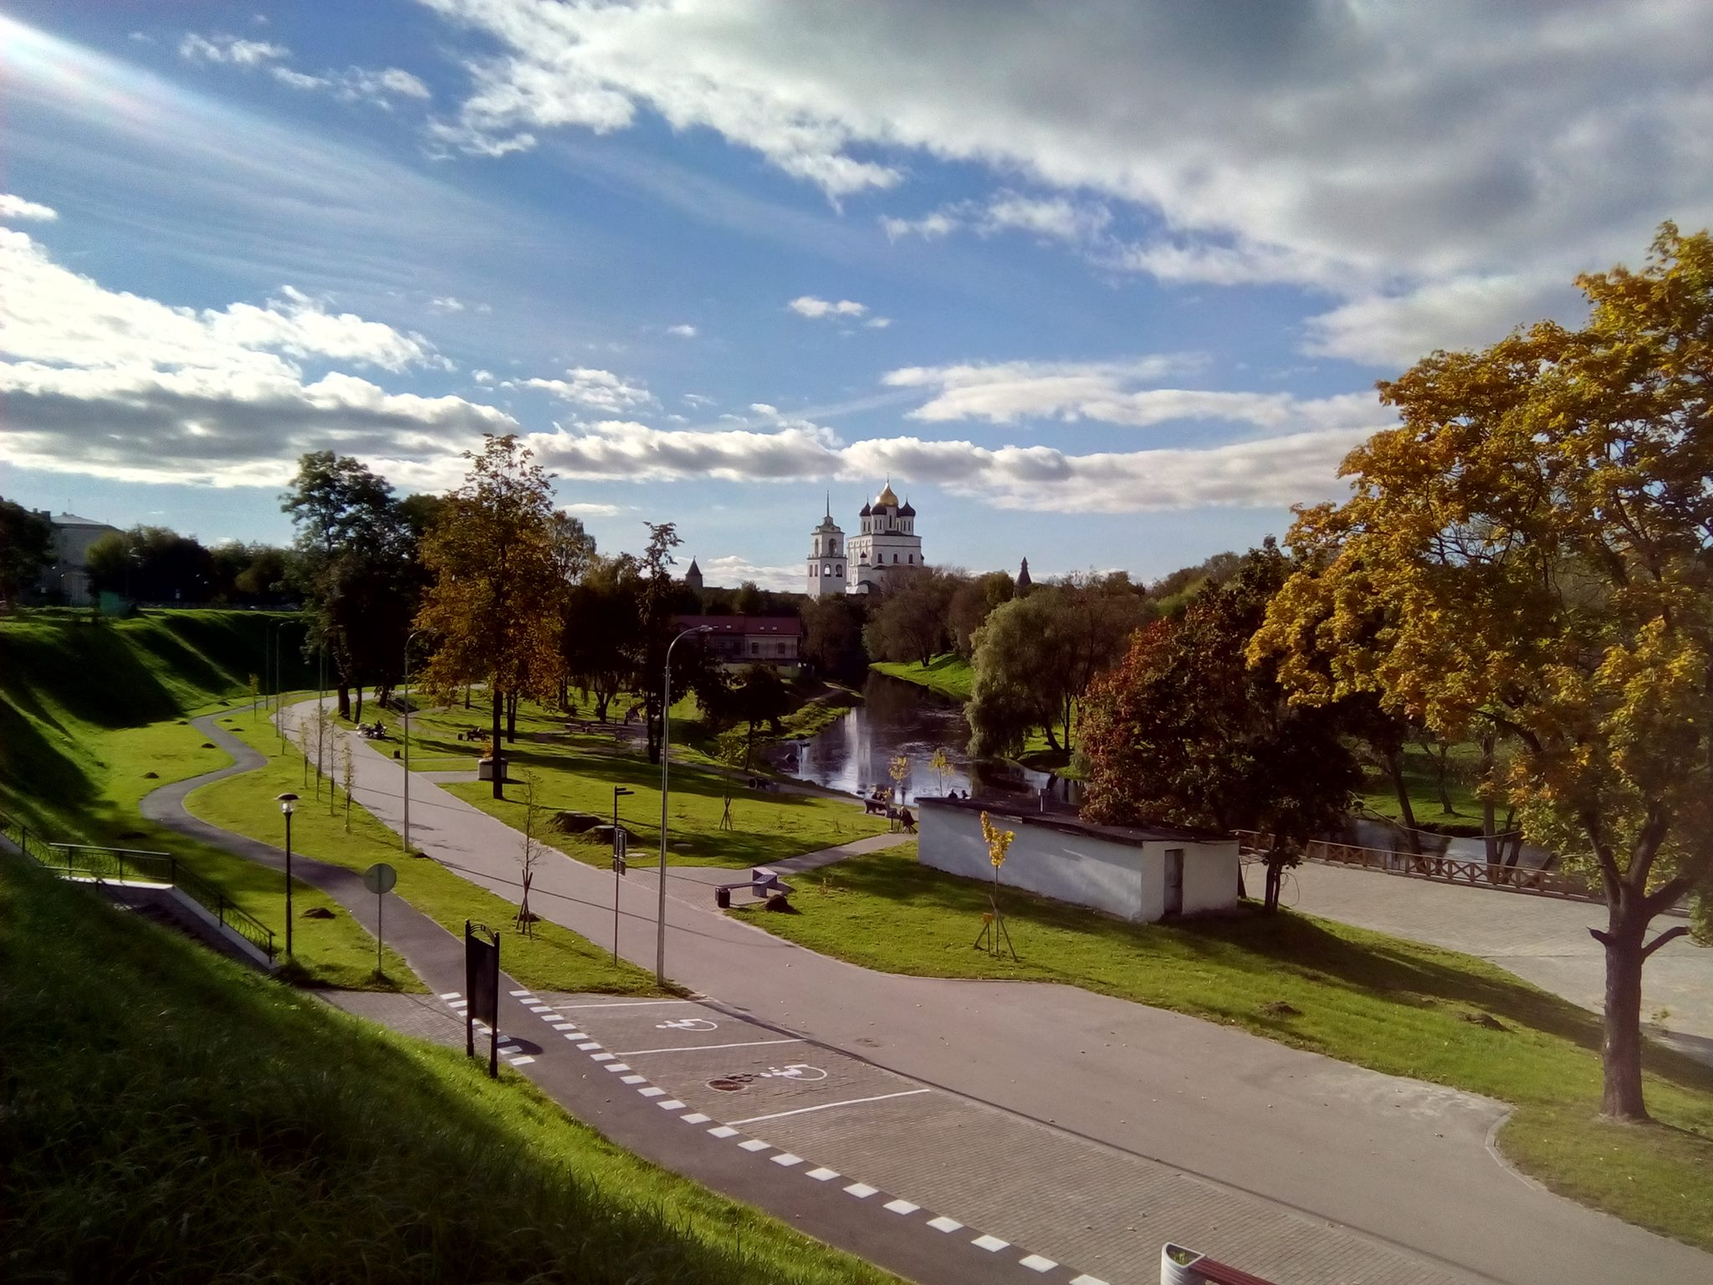
In Conclusion

